Slide 1
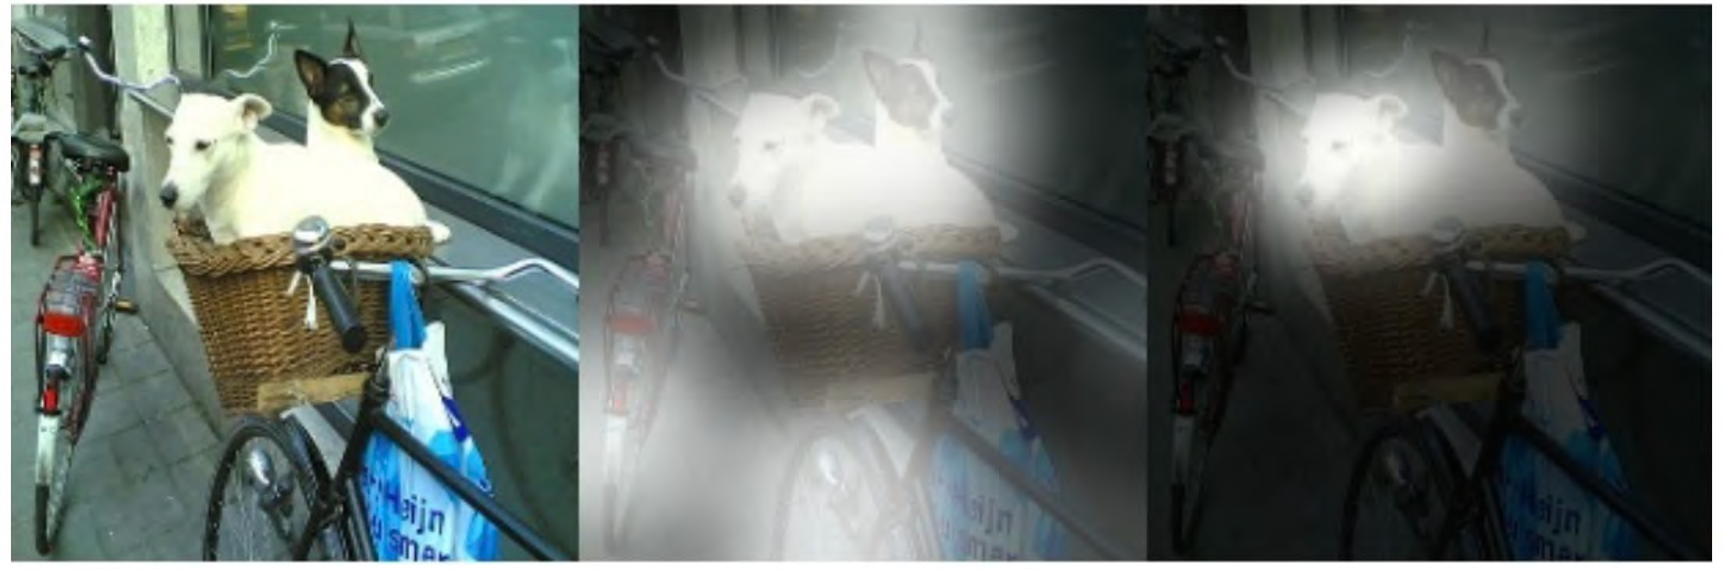
3. Iterative Pooling
original image
first attention layer
second attention layer
d2l.ai
Notes:
重複做pooling
每做一次就縮有一次範圍

Slide 2
Question Answering
Joe went to the kitchen. Fred went to the kitchen. Joe picked up the milk.
Joe travelled to the office. Joe left the milk.
Joe went to the bathroom.
Where is the milk?
d2l.ai

Slide 3

Question Answering
Joe went to the kitchen. Fred went to the kitchen.
Joe picked up the milk.
Joe travelled to the office.
Joe left the milk.
Joe went to the bathroom.
Where is the milk?
d2l.ai

Slide 4
Question Answering
Joe went to the kitchen. Fred went to the kitchen.
Joe picked up the milk.
Simple attention selects sentences with ‘milk’.
Attention pooling doesn’t help much since it misses intermediate steps.
Joe travelled to the office.
Joe left the milk.
Joe went to the bathroom.
Where is the milk?
d2l.ai

Slide 5
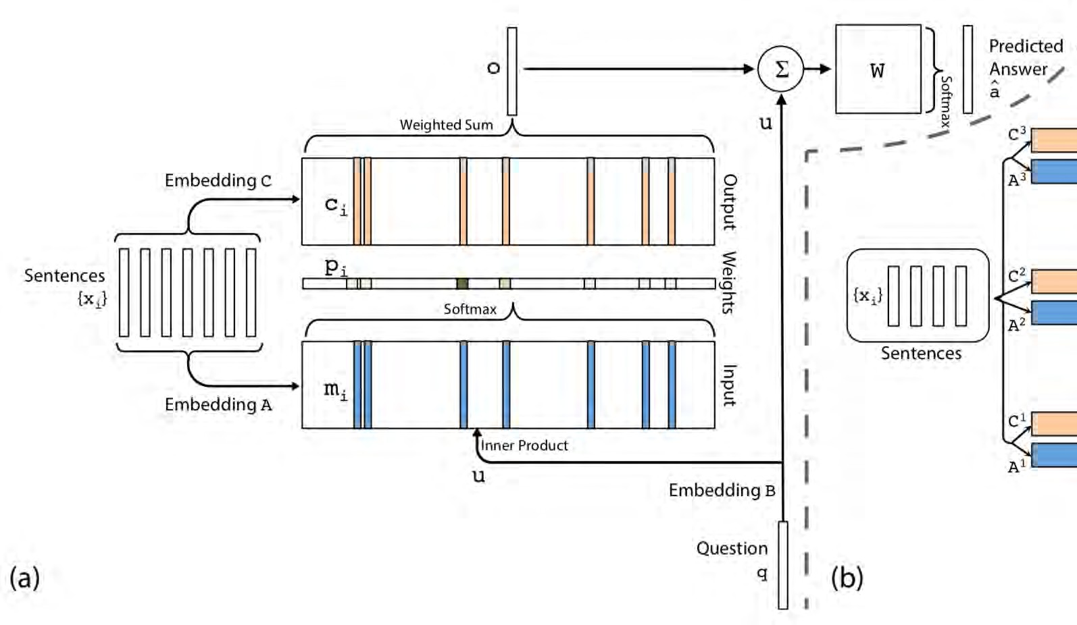



Question Answering with Pooling (Sukhbaatar et al., ’15)
value
Simple attention selects sentences with ‘milk’.
Attention pooling doesn’t help much since it misses intermediate steps.
key
query
https://d2l.ai

Slide 6
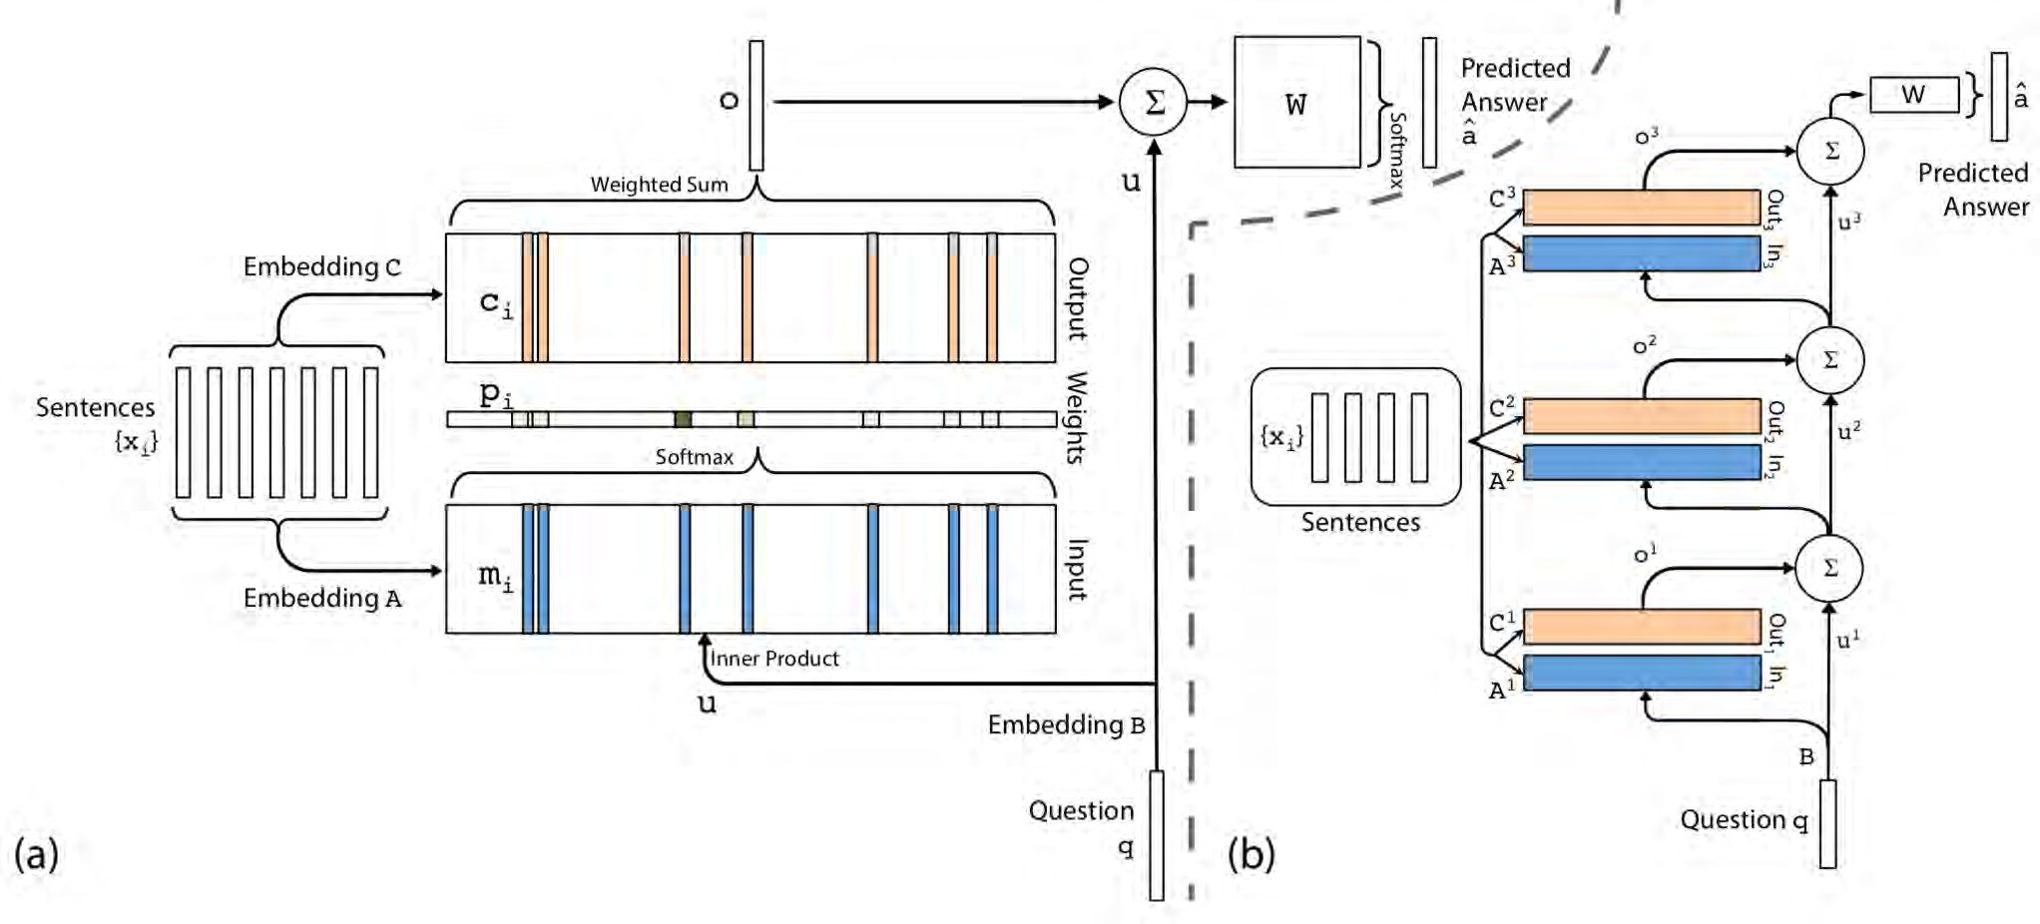
Question Answering with Pooling and Iteration (Sukhbaatar et al., ’15)
o = ∑ c_{i} p_{i}
value
i
key
iterative attention
query
https://d2l.ai

Slide 7
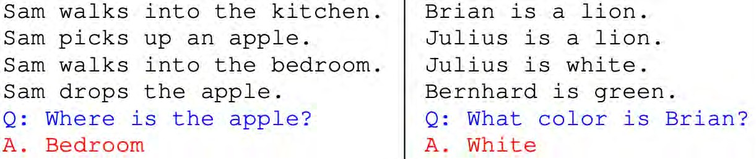
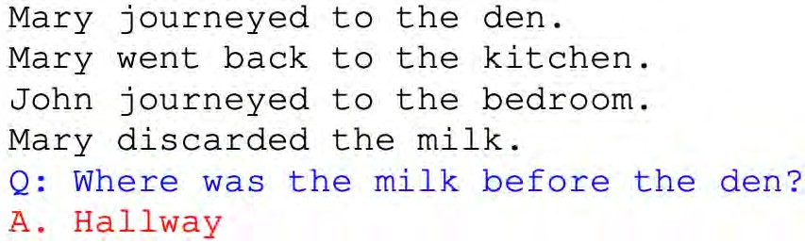
Question Answering with Pooling and Iteration (Sukhbaatar et al., ’15)
https://d2l.ai

Slide 8
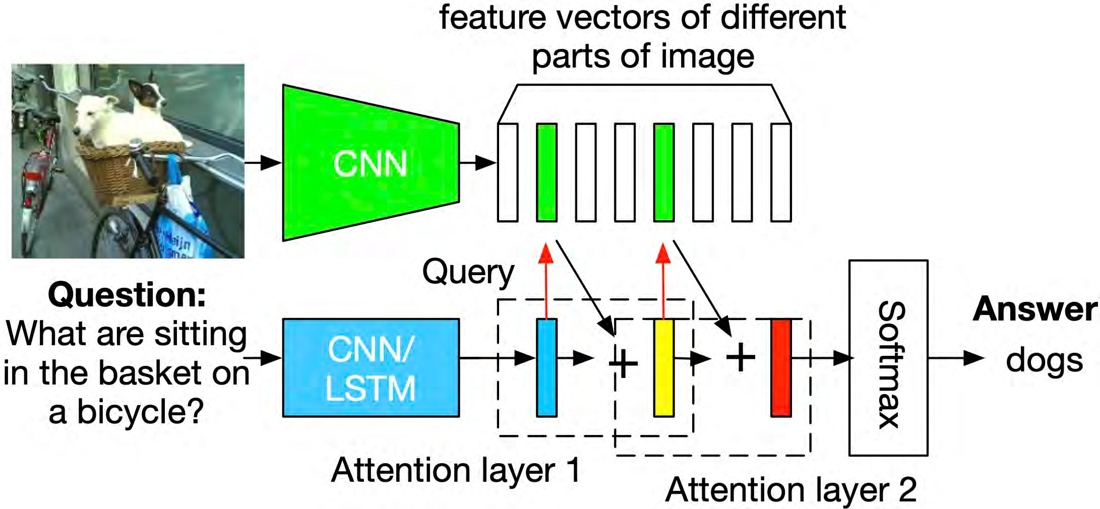

Question Answering with Pooling and Iteration (Yang et al., ’16)
key & value
d2l.ai

Slide 9
Question Answering with Pooling and Iteration (Yang et al., ’16)
Encode image via CNN
Encode text query via LSTM
Weigh patches according to attention and iterate
Improving it (2019 tools)
Convolutionalize CNN (e.g. ResNet)
BERT for query encoding
Convolutional weighting (a la SE-Net)
d2l.ai

Slide 10
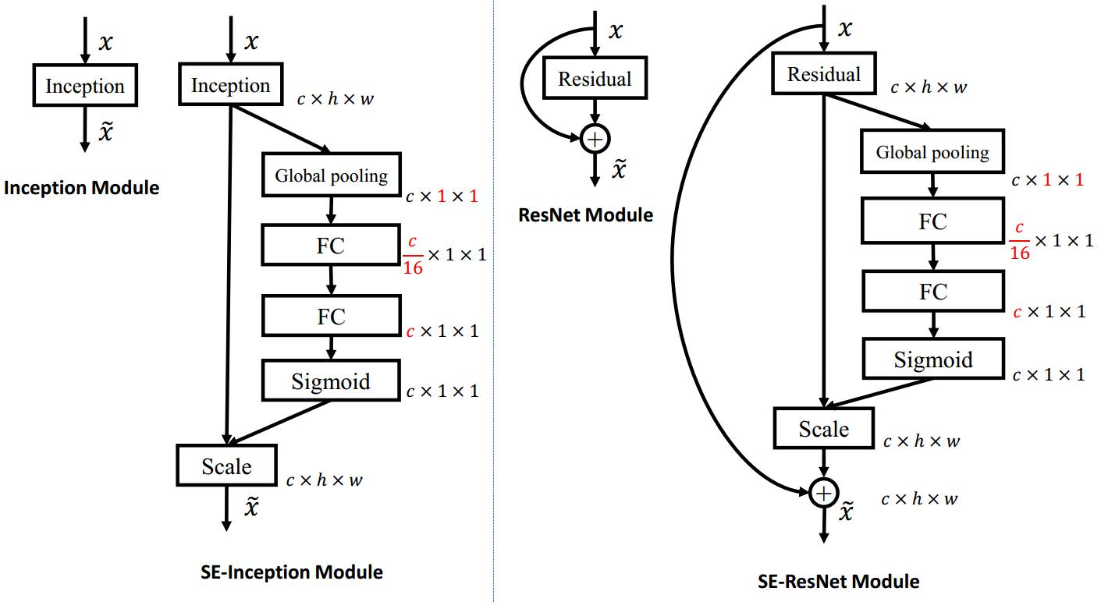
SENET

Slide 11
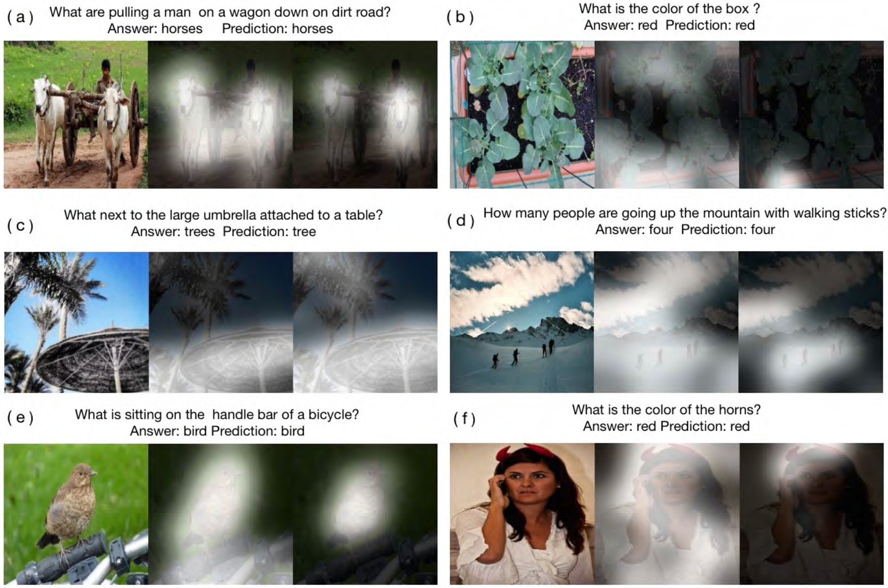
d2l.ai

Slide 12
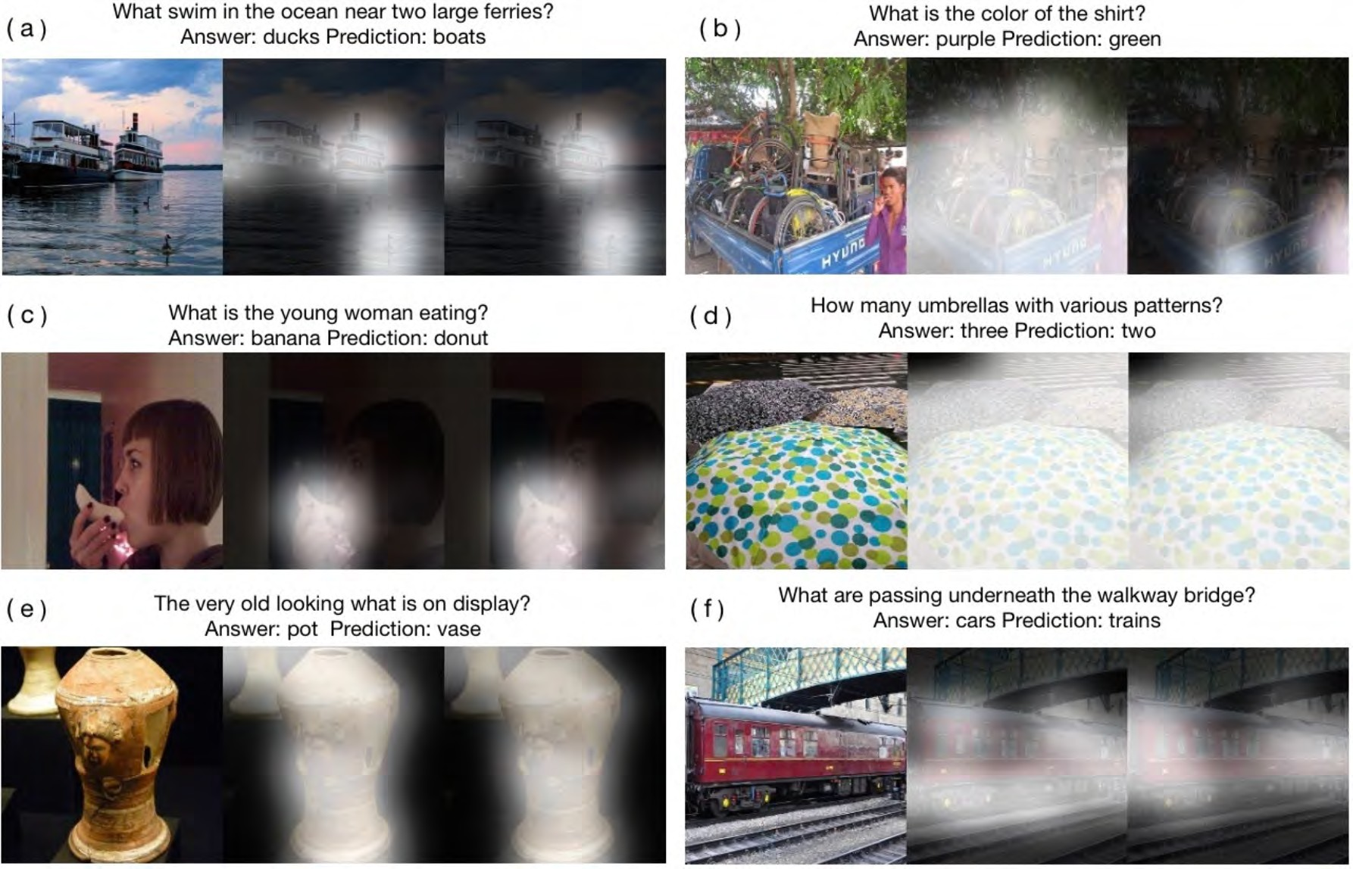
d2l.ai

Slide 13

Iterative Attention Summary
Pooling
f (X ) = ρ
ϕ(x)
(
(
(
∑
)
x∈X
Attention pooling
f (X ) = ρ
Iterative Attention pooling
α(x, w)ϕ(x)
∑
)
x∈X
Repeatedly update internal state
ρ
α(x, q )ϕ(x)
^{q}t+1 ⁼
∑
t
)
x∈X
d2l.ai

Slide 14
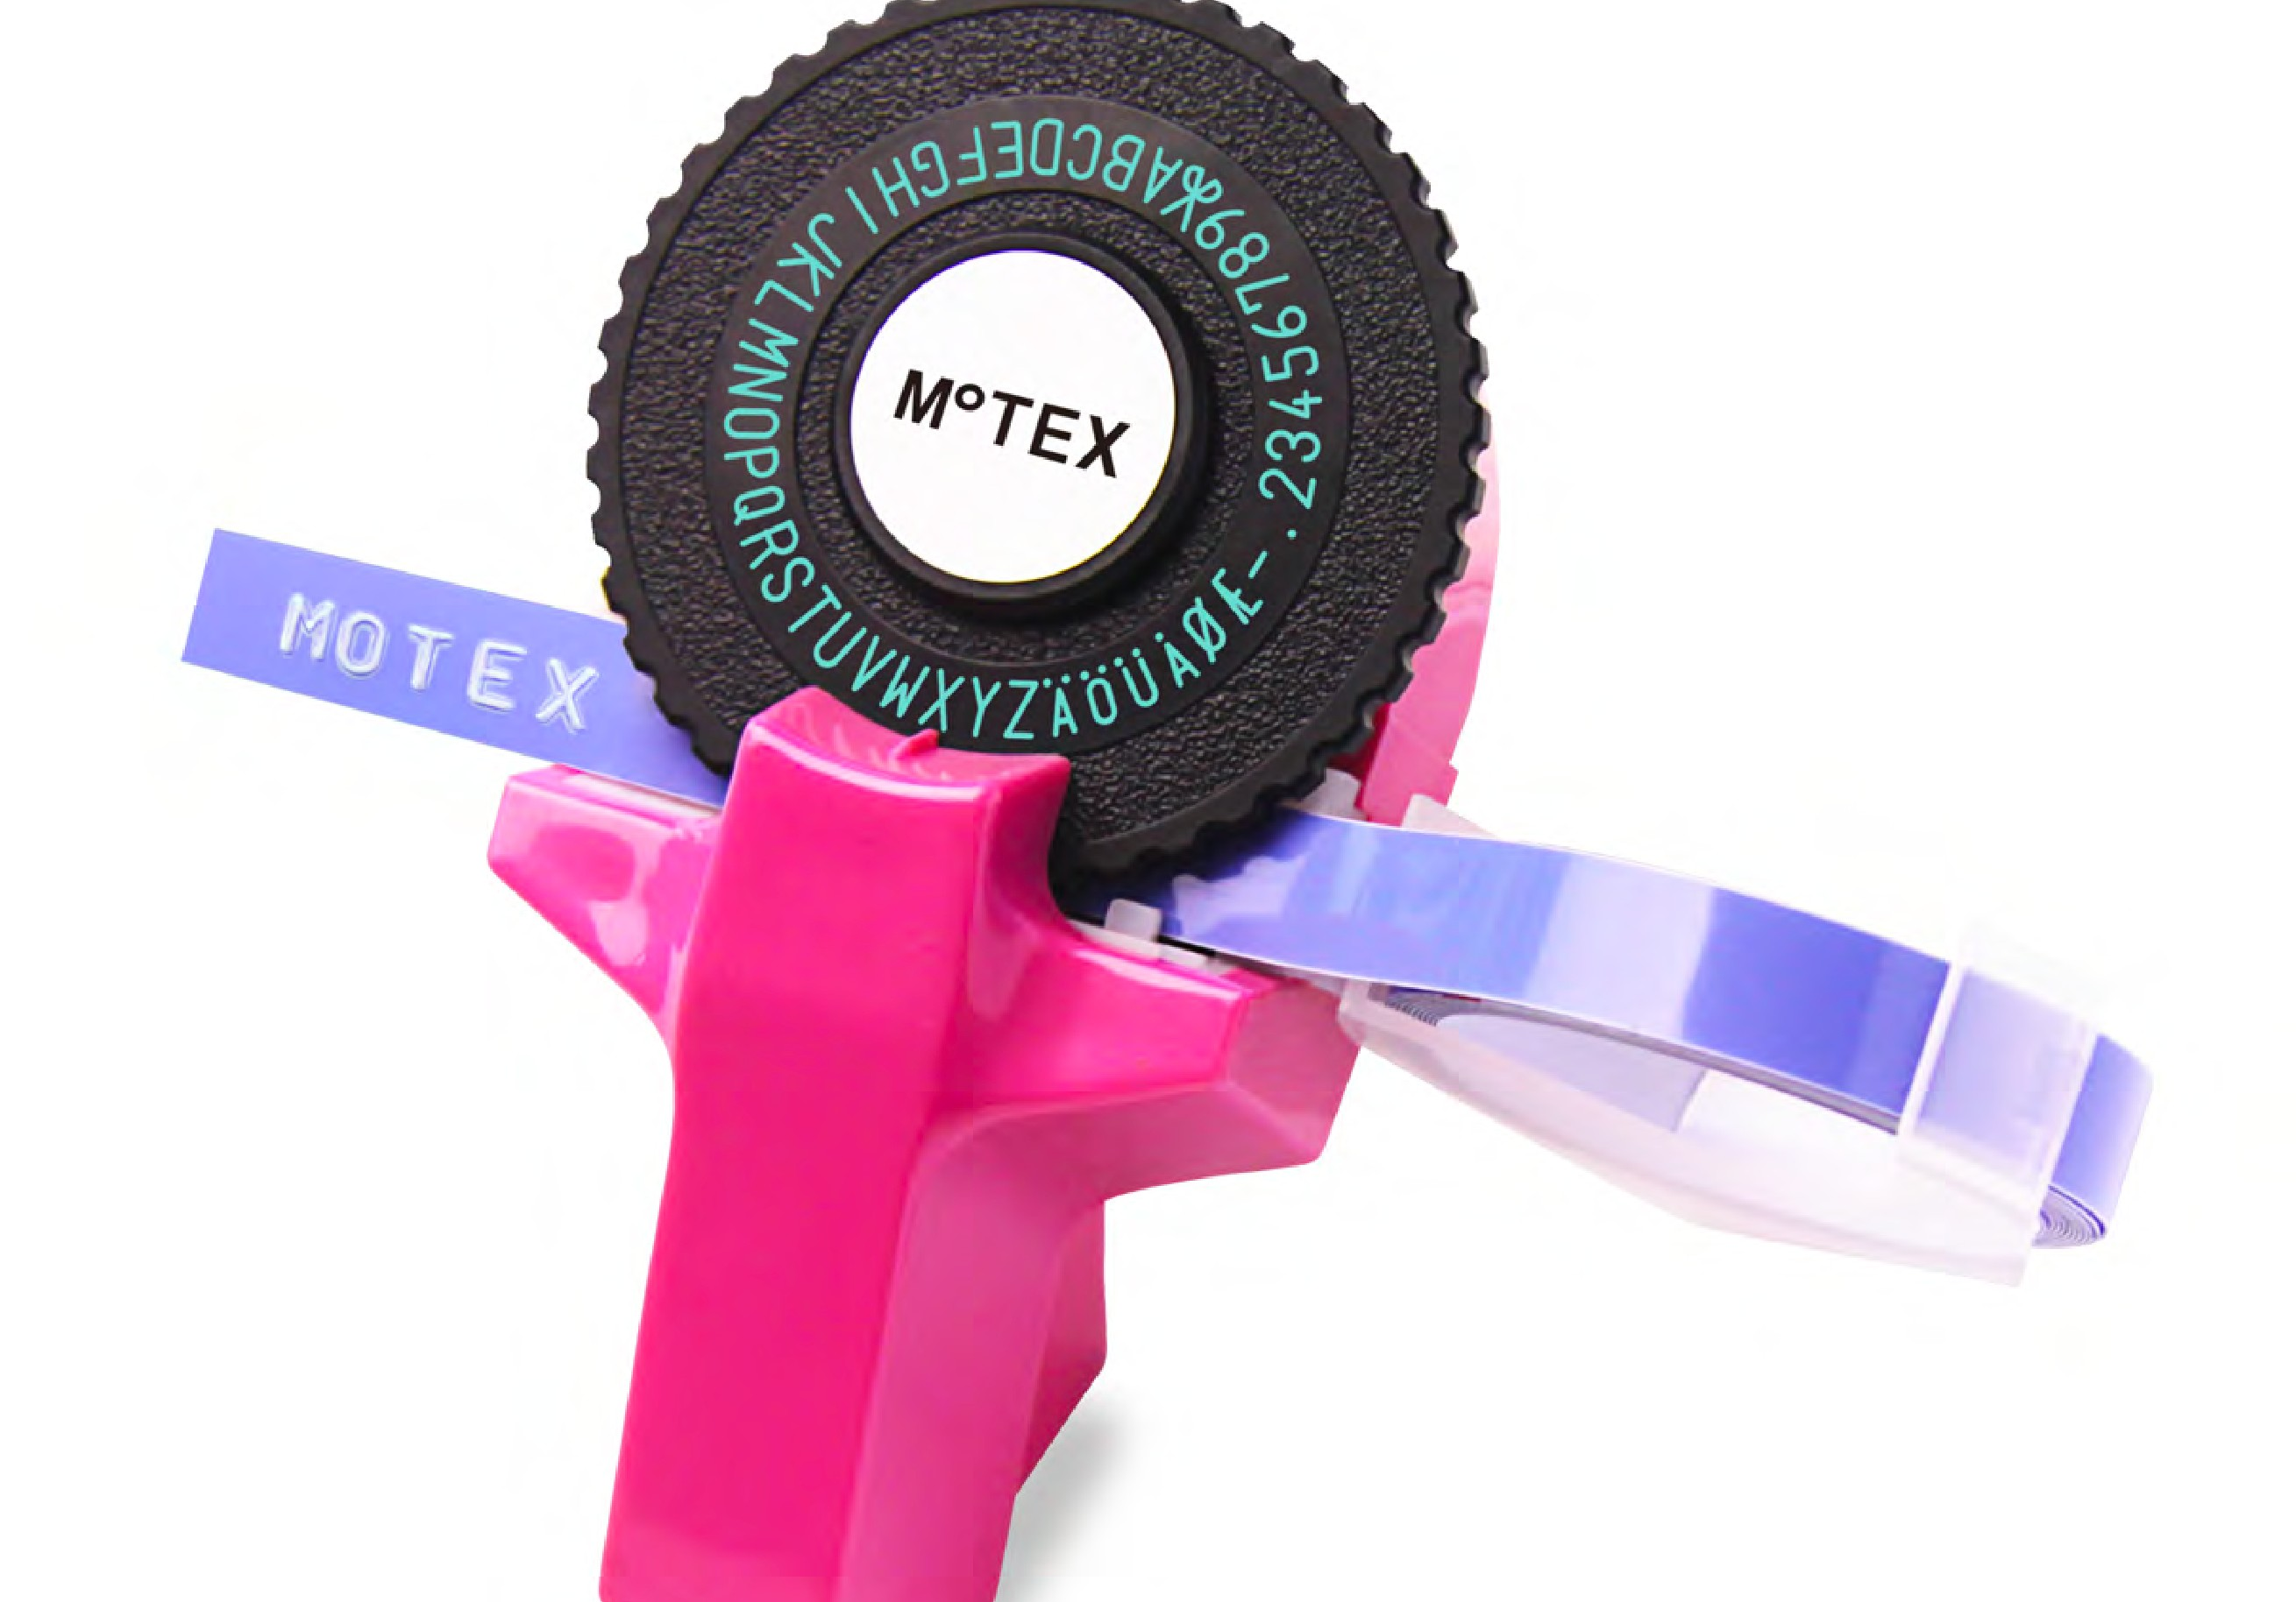

4. Iterative
Output
d2l.ai

Slide 15

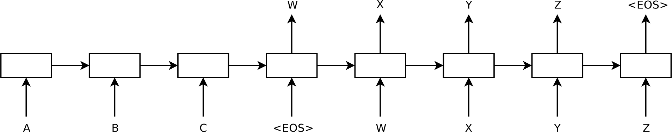
Seq2Seq for Machine Translation, Sutskever, Vinyals, Le ‘14
Encode source sequence s via LSTM to representation ϕ(s)
Decode to target sequence one character at a time
ϕ(s)
• ‘The table is round.’ - ‘Der Tisch ist rund.’
• ‘The table is very beautiful with many inlaid patterns, blah blah blah blah’ - ‘Error …’
d2l.ai

Slide 16

Seq2Seq for Machine Translation, Sutskever, Vinyals, Le ‘14
Encode source sequence s via LSTM to representation ϕ(s)
Decode to target sequence one character at a time
ϕ(s)
‘The table is round.’ - ‘Der Tisch ist rund.’
‘The table is very beautiful with many inlaid pattern
Representation
not rich enough
blah blah blah blah’ - ‘Error …’
d2l.ai
Notes:
Need memory for long sequences
Attention to iterate over source

Slide 17
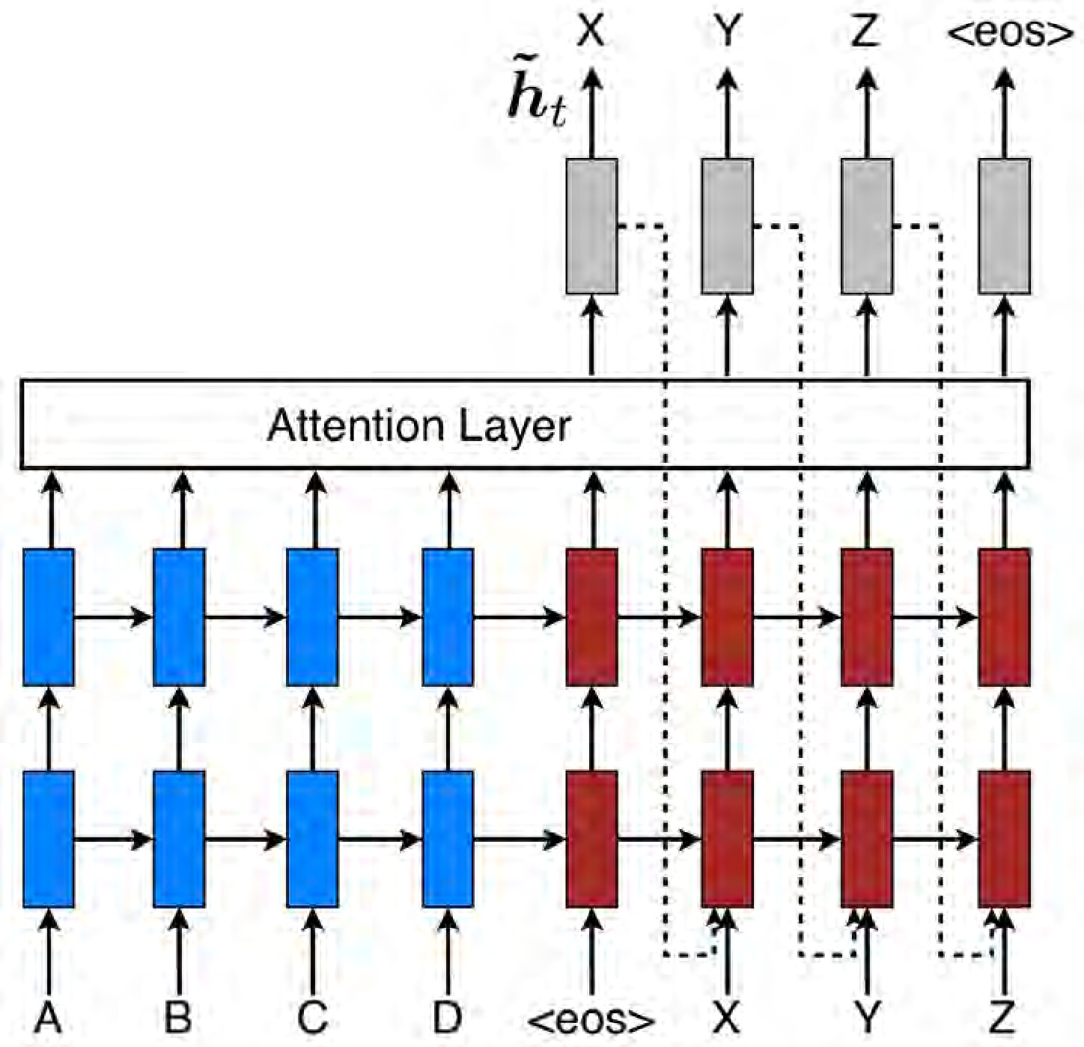
Seq2Seq with attention (Bahdanau, Cho, Bengio ’14) (Pham, Luong, Manning ’15)
https://d2l.ai

Slide 18
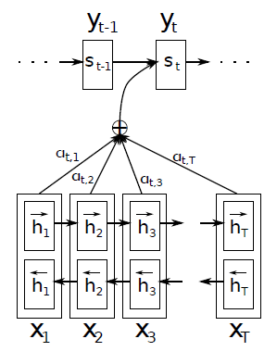
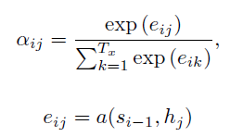
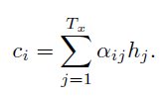
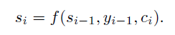
Seq2Seq with attention (Bahdanau, Cho, Bengio ’14) (Pham, Luong, Manning ’15)
https://d2l.ai

Slide 19
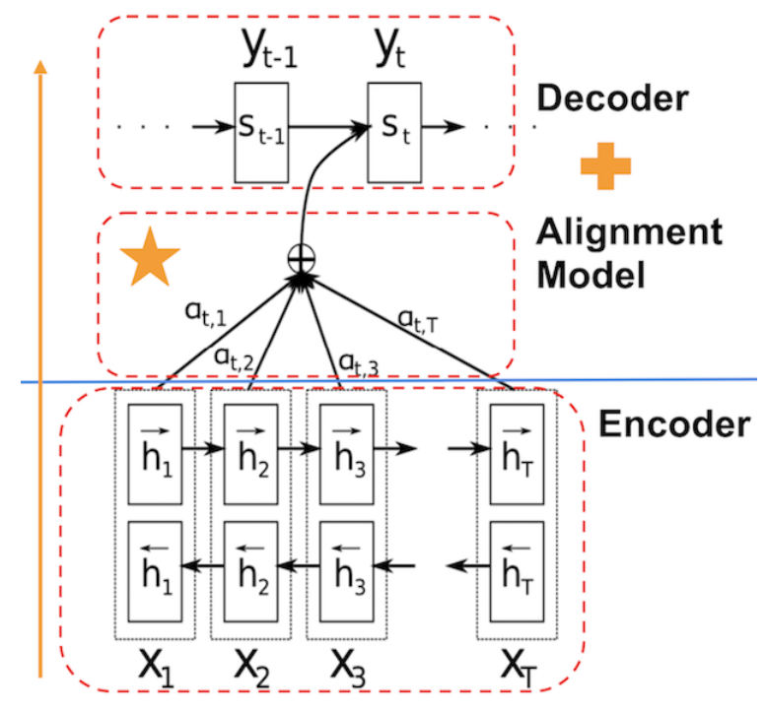
Seq2Seq with attention (Bahdanau, Cho, Bengio ’14) (Pham, Luong, Manning ’15)
https://d2l.ai

Slide 20
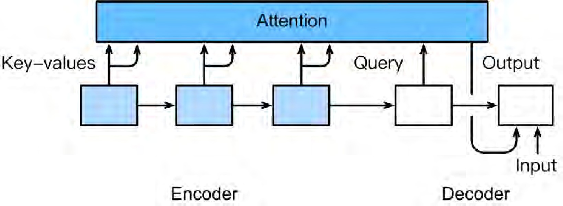

Seq2Seq with attention (Bahdanau, Cho, Bengio ’14) (Pham, Luong, Manning ’15)
Iterative attention model
Compute (next) attention weights
Aggregate next state
Emit next symbol
Repeat
Memory networks emit only one symbol.
NMT with attention emits many symbols.
d2l.ai

Slide 21
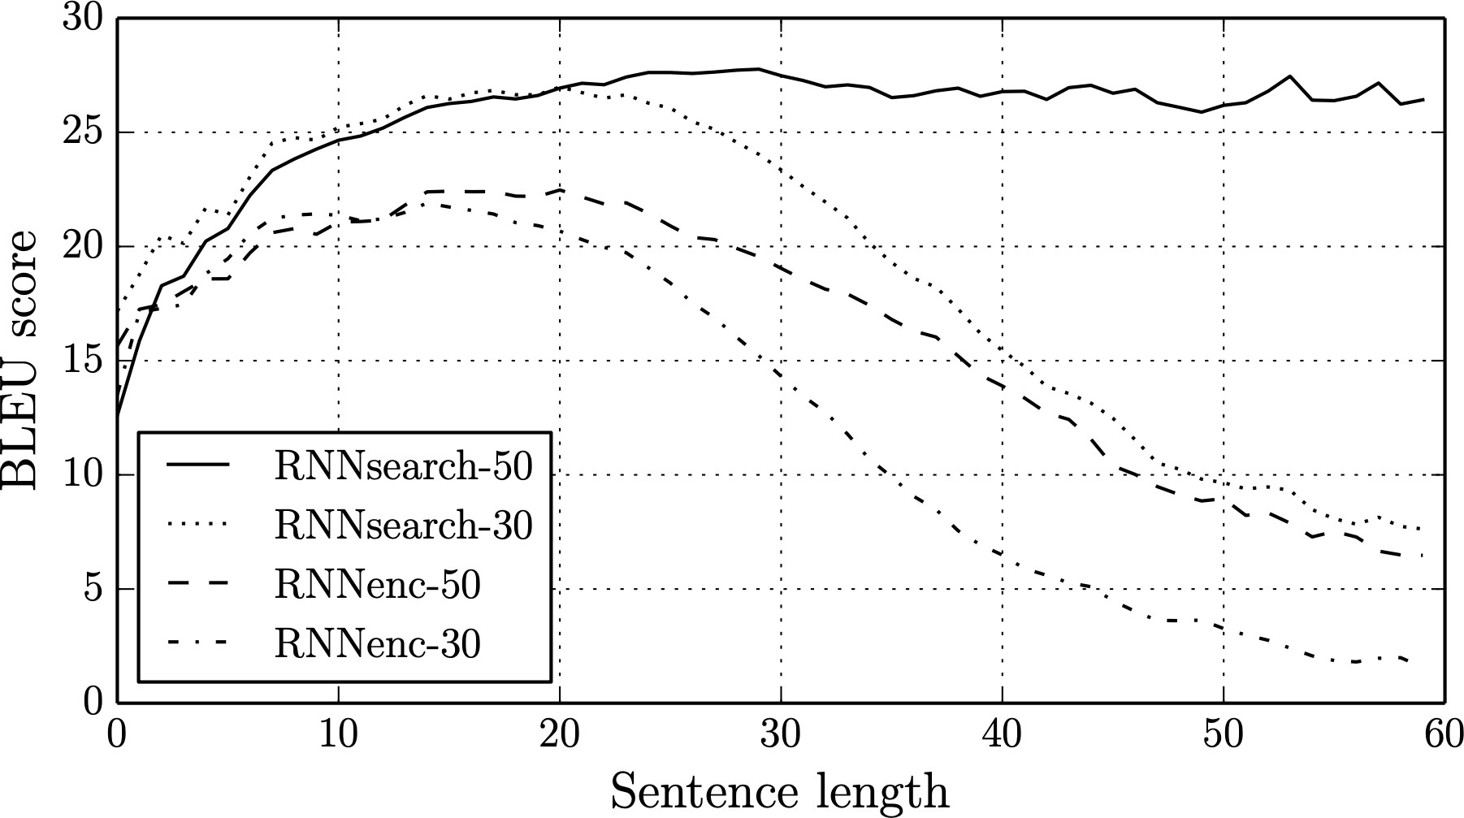

Seq2Seq with attention (Bahdanau, Cho, Bengio ’14)
With attention
d2l.ai

Slide 22
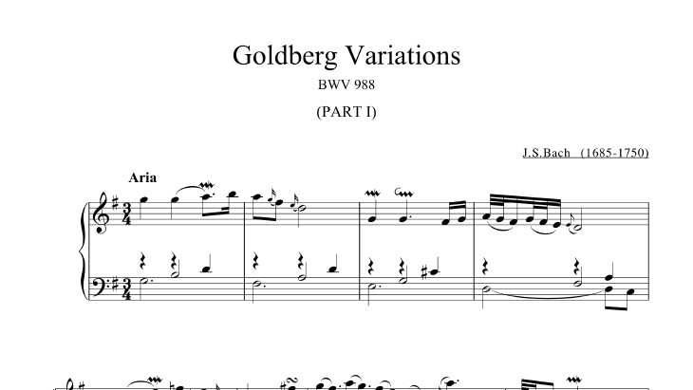
Variations on a Theme
4.3 Variations on a theme
d2l.ai

Slide 23
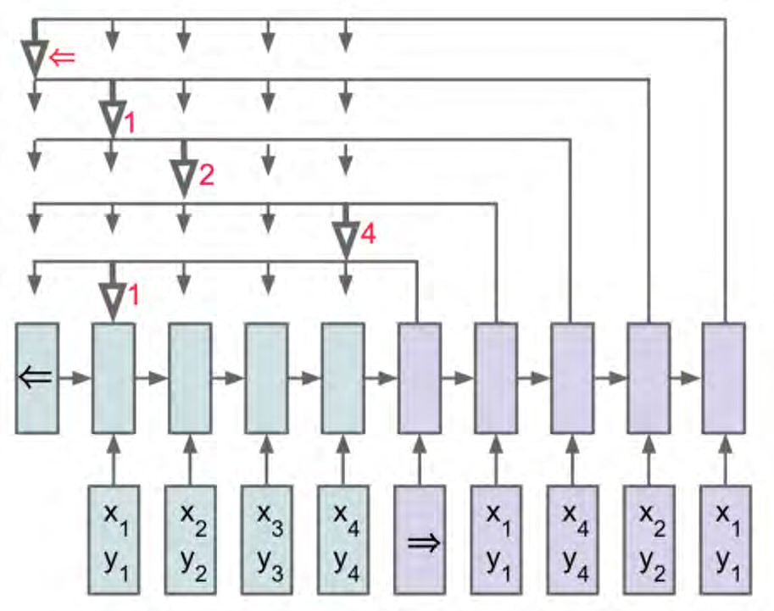
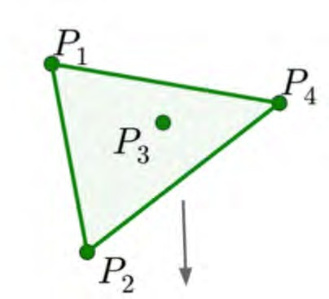
Pointer networks for finding convex hull (Vinyals et al., ‘15)
Input P = {P₁, …P₄} Output O = {1,4,2,1}
https://d2l.ai

Slide 24



Pointer networks for finding convex hull (Vinyals et al., ‘15)
Input P = {P₁, …P₄} Output O = {1,4,2,1}
key
query
u_{ij} = v⊤ tanh(W[e_{j}, d_{i}]) p(C_{i} | C_{[1:i−1]}, P) = softmax(u_{i})
attention weight as prediction distribution
encoder state: ej
decoder state: di
https://d2l.ai

Slide 25
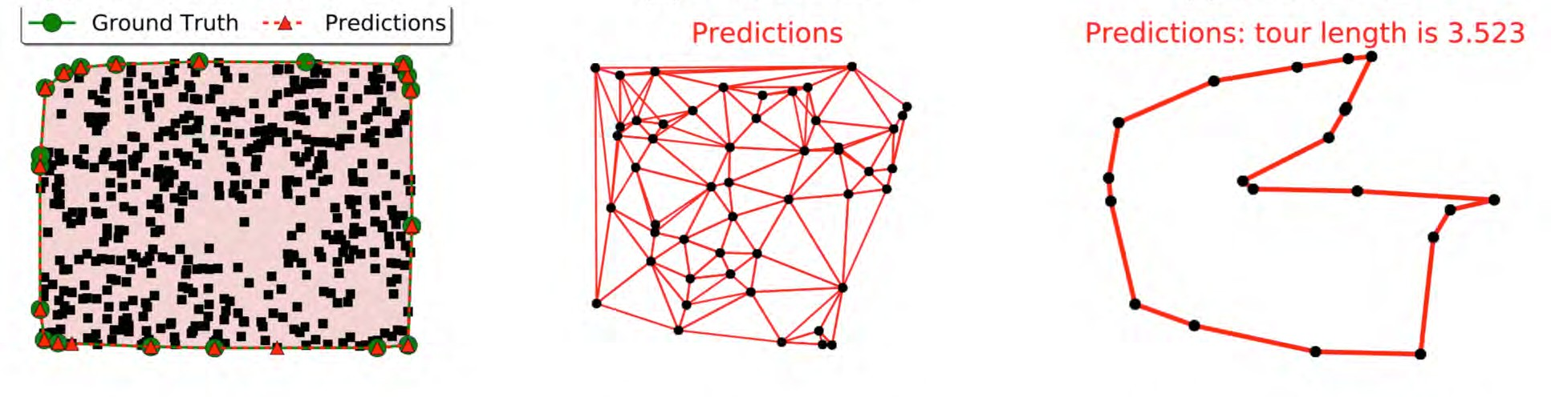
Convex hulls, Delaunay triangulation, and TSP
2019 style improvements
Transformer to encode inputs (and outputs)
Graph neural networks for local interactions
d2l.ai

Slide 26
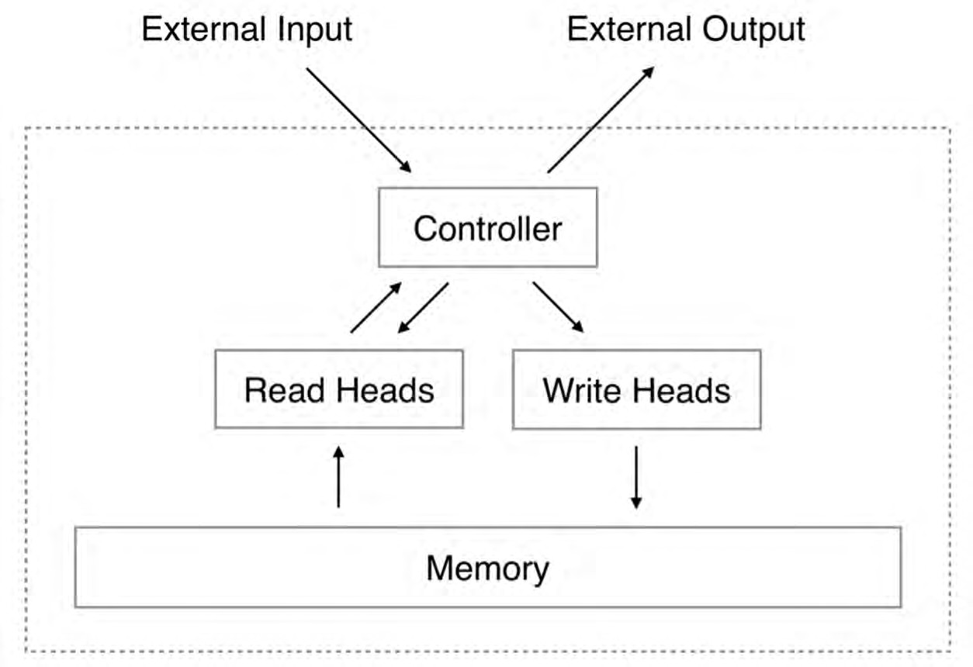





Neural Turing Machines (Graves et al., ‘14)
attention weight
r_{t} ← ∑ w_{t}(i)M_{t}(i)
i
value
https://d2l.ai

Slide 27

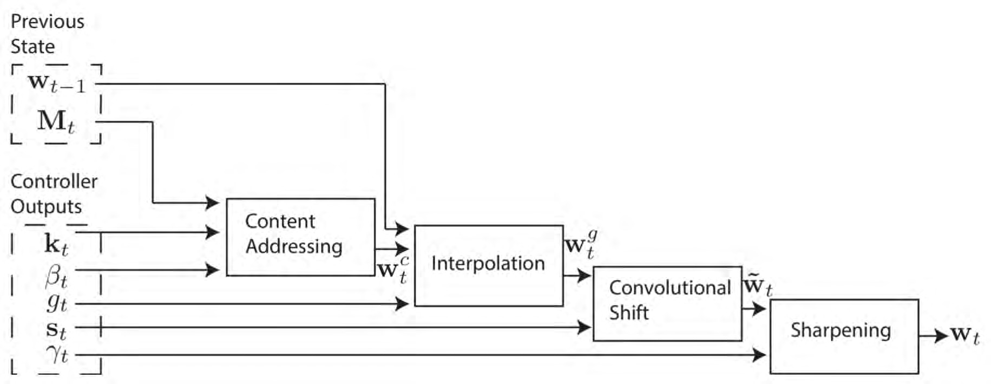

Attention weights can be stateful (values, too)
attention weight
value
https://d2l.ai

Slide 28
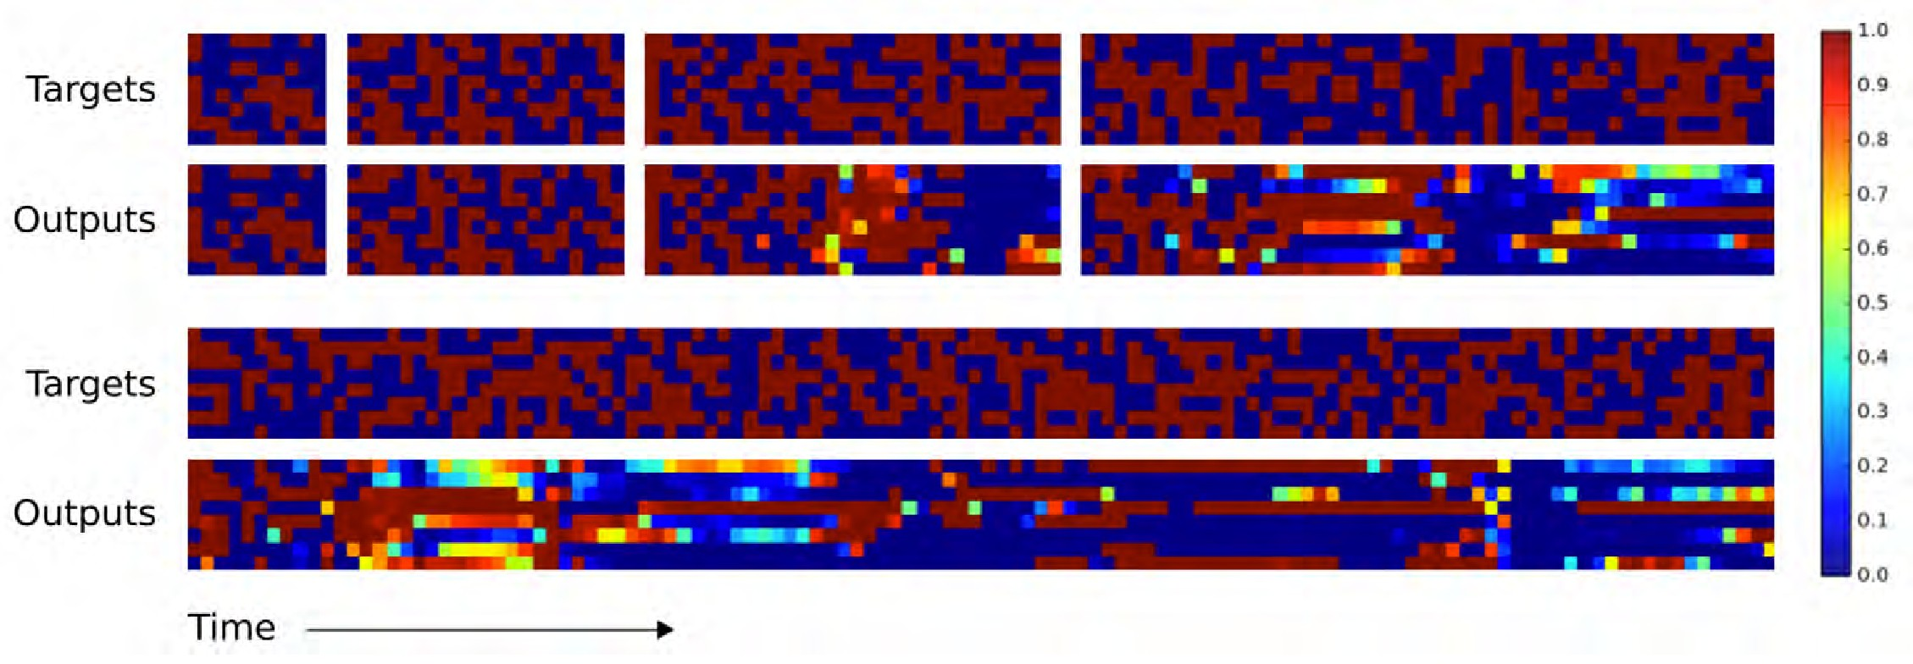
Copying a sequence (with LSTM)
10
20
30
50
120
https://d2l.ai

Slide 29
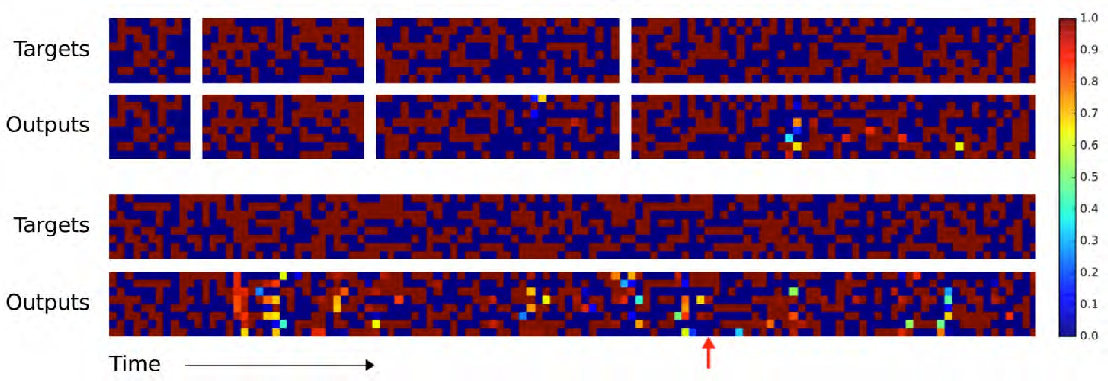
Copying a sequence (with NTM)
10
20
30
50
120
global error: push all subsequent
https://d2l.ai
vectors one step back

